Slide 1

SWP391: FINAL PROJECT PRESENTATION
Children Care System
SE1874-SAP
Group 3
Supervisor:
Mr.Nguyen Manh Hien
Group Member:
Bùi Hoàng Nguyệt Anh HE180164 (Leader)
Phạm Chí Dũng HE171832
Nguyễn Quốc Long HE172355
Nguyễn Thùy Linh HE181703
Nguyễn Thị Thanh HE182518

Slide 2
Project Overview
Table of Contents
Project Introduction
System Architecture Overview
Actor & Feature
Demonstration
Outcomes
Q&A

Slide 3






Project Introduction
Children Care System is a new software system being developed to provide an online platform for parents and guardians to register reservations for their child. The system will support features such as scheduling doctor appointments, and accessing child care information. The context diagram below illustrates the external entities and system interfaces. Future releases are planned to include additional services, such as integrating an online medical consultation service with pediatricians and payment processing through VNPay.

Slide 4
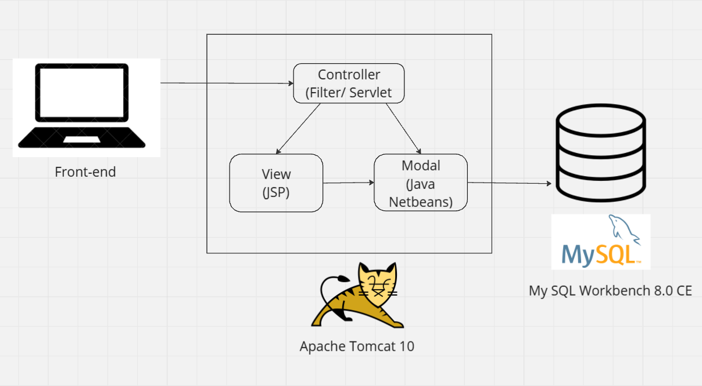
System Architecture Overview
Tech stack:
JSP Servlet
MySQL
Tomcat 10
ReactJS

Slide 5



Actors & Features
Customer
Guest
Admin
View/Update Profile
Reset Password
Change Password
Feedback Service
View Service
Add To Cart
View/Update/Delete Cart
View/Create/Cancel Reservation
Manage User Account
Setting
View Admin Dashboard
Register
Login
View Homepage
View Blog
View Service

Slide 6



Actors & Features
Manager
Doctor
Cashier
Manage Customer
Manage Service
Manage Blog
Manage Feedback
Manage Slider
View Manager Dashboard
Medical examination
Add service
Add prescription
Check-in, check out
Fee collection

Slide 7
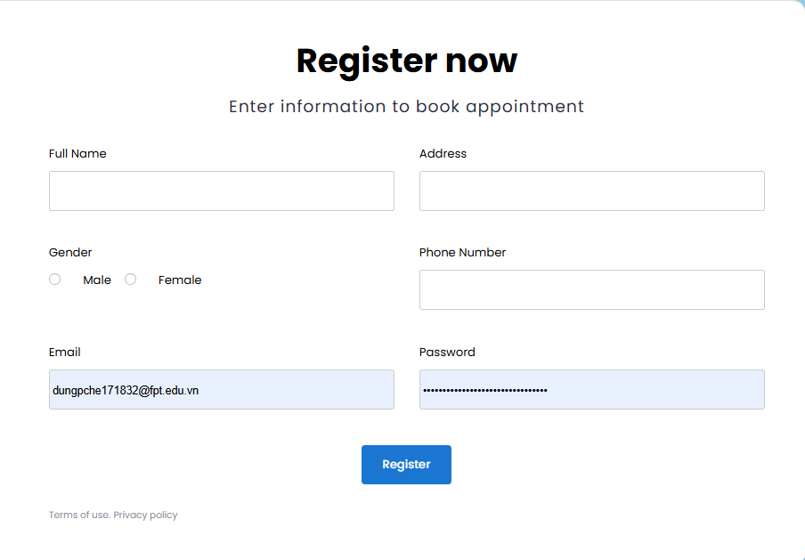
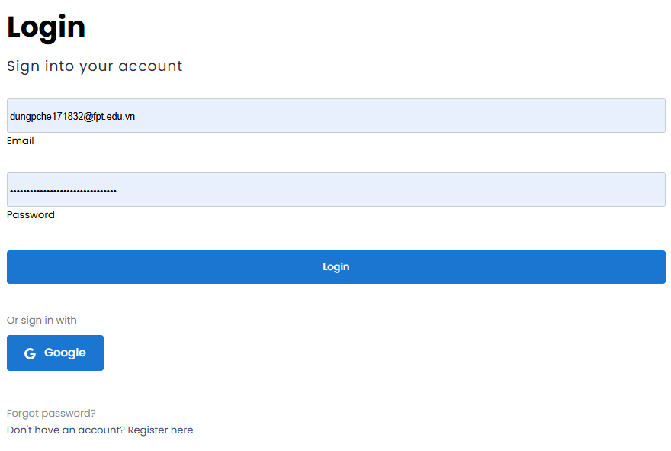
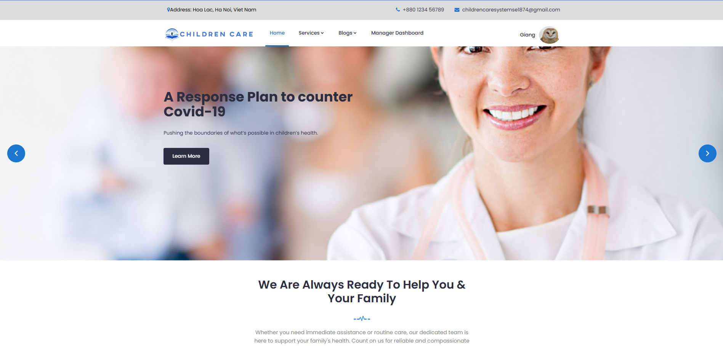
Demonstration|Login and Register
Guest
I want to Register

Slide 8
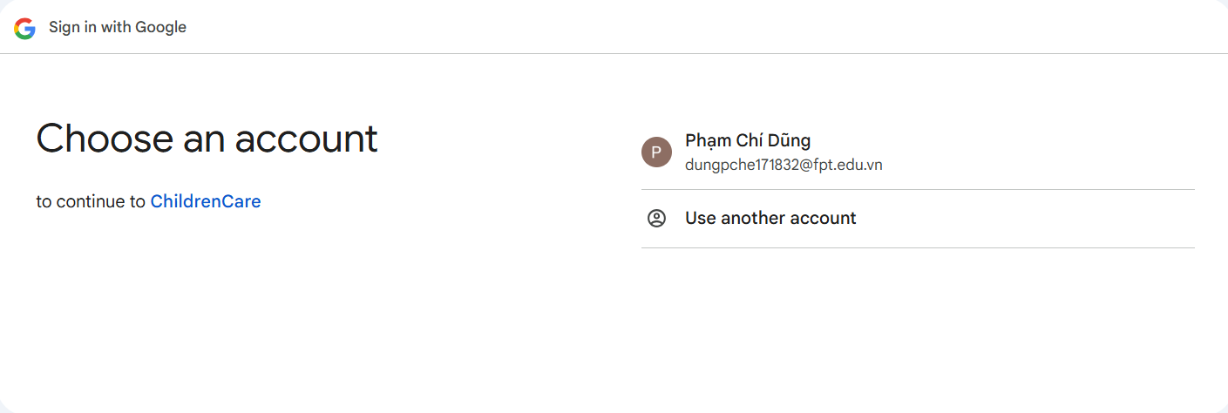
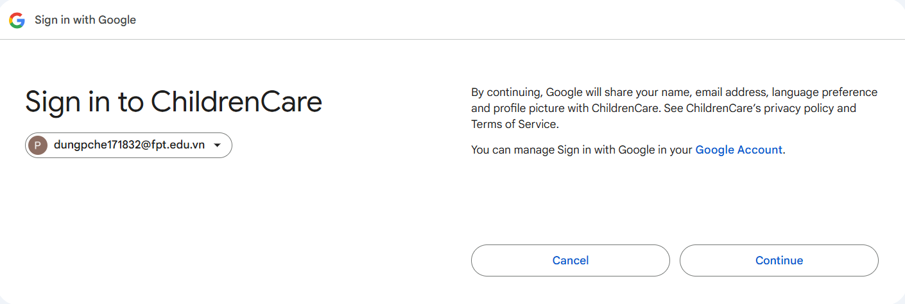
Demonstration|Login with google account
Guest
I want to Register

Slide 9
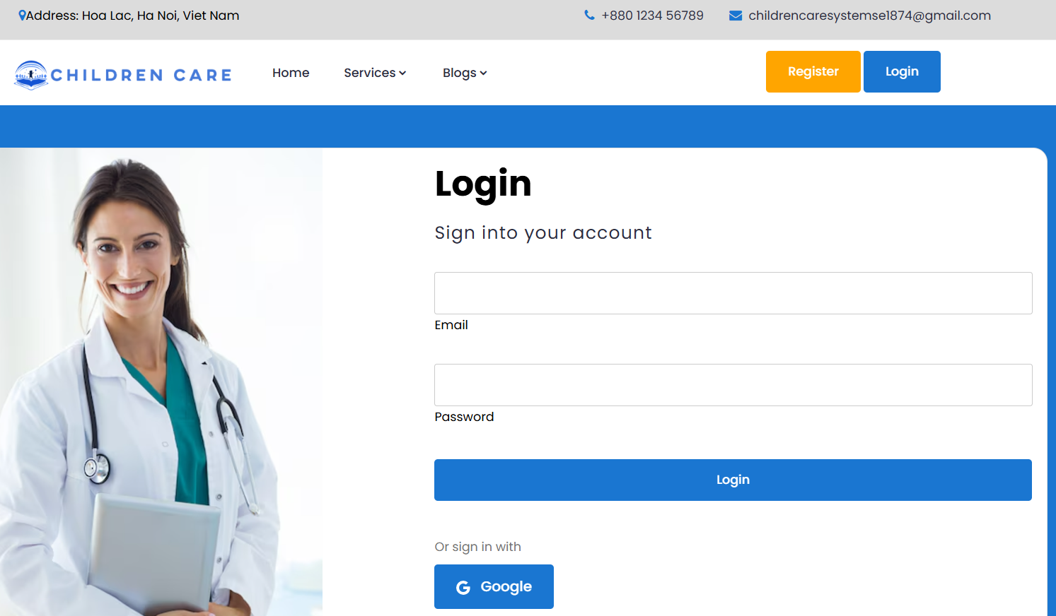
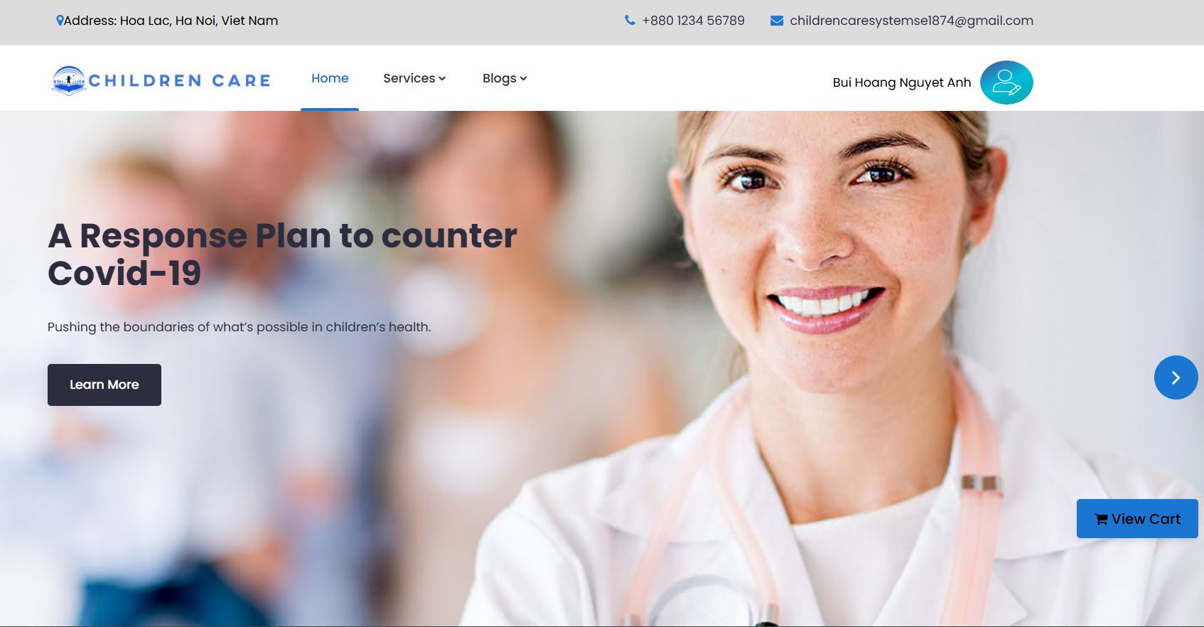
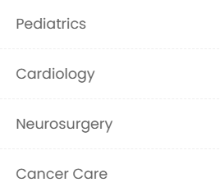
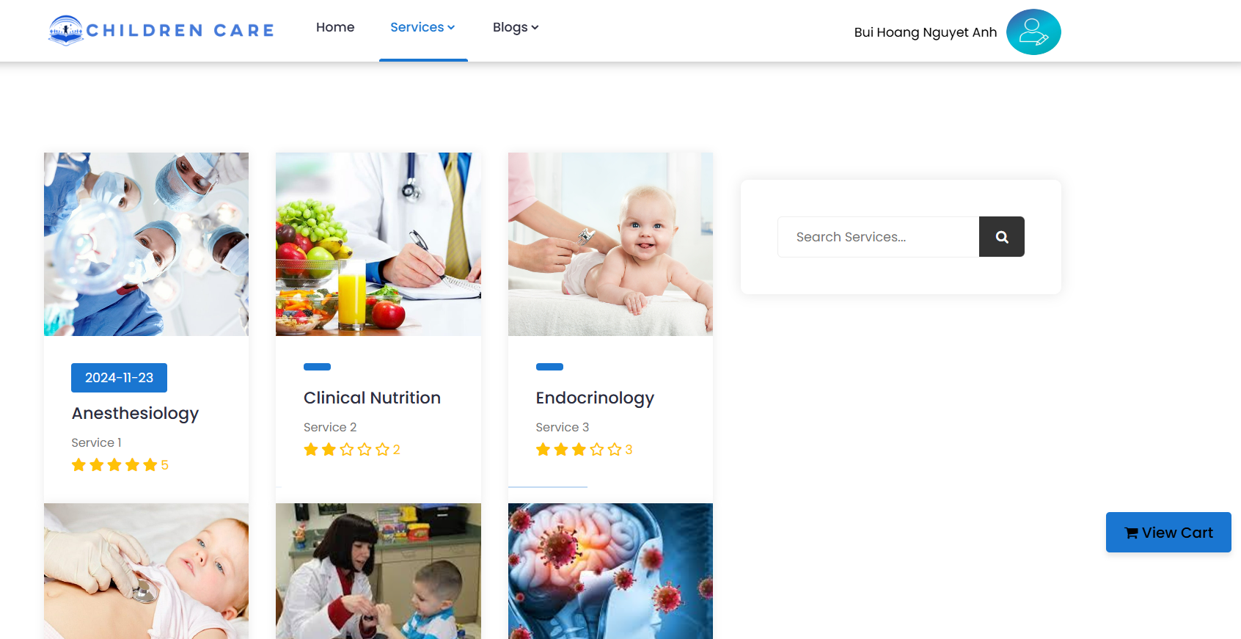

Demonstration|Home and Service Browsing
Login to system
Go to home page
Guest
Filter service by category
Filter service
Search by name

Slide 10
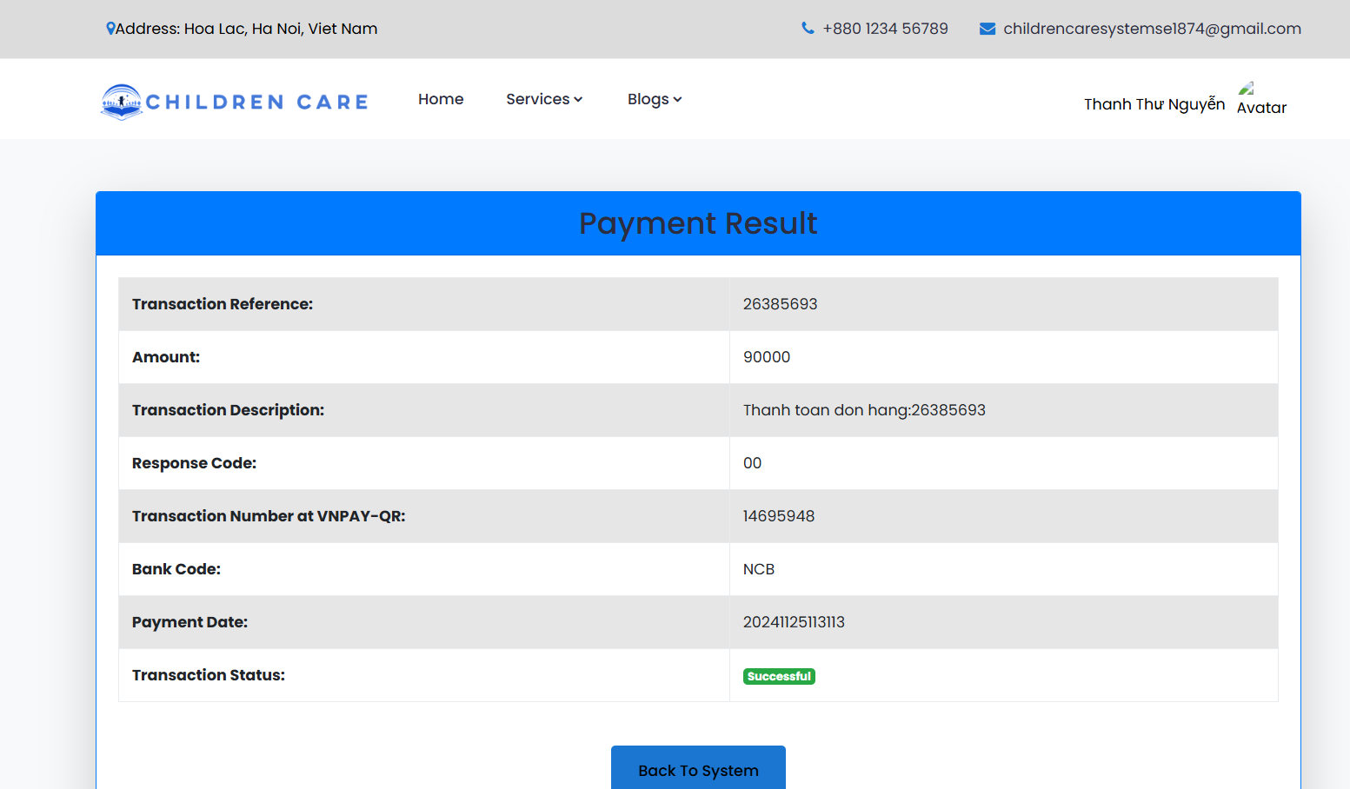
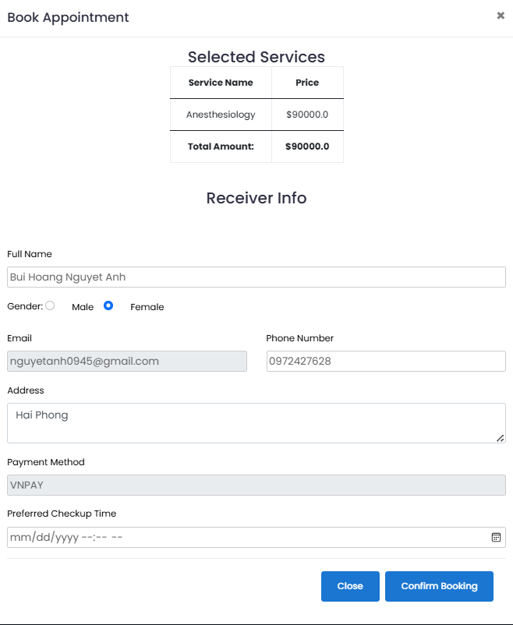
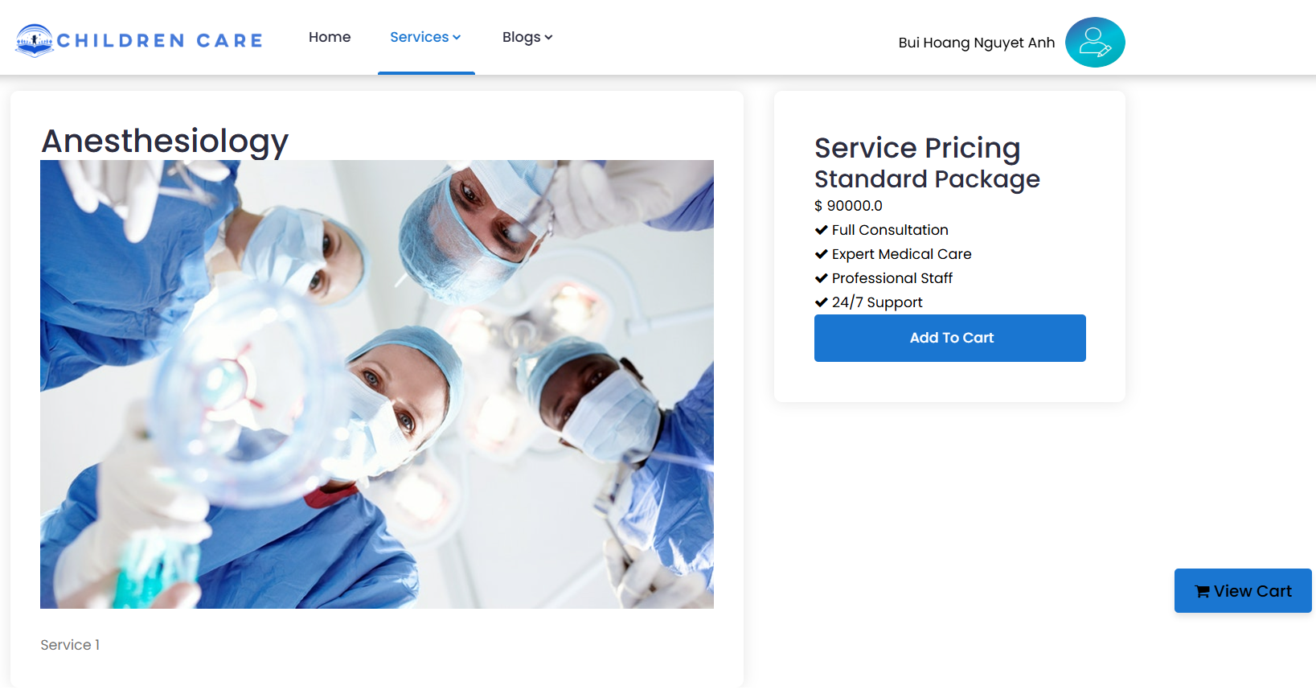
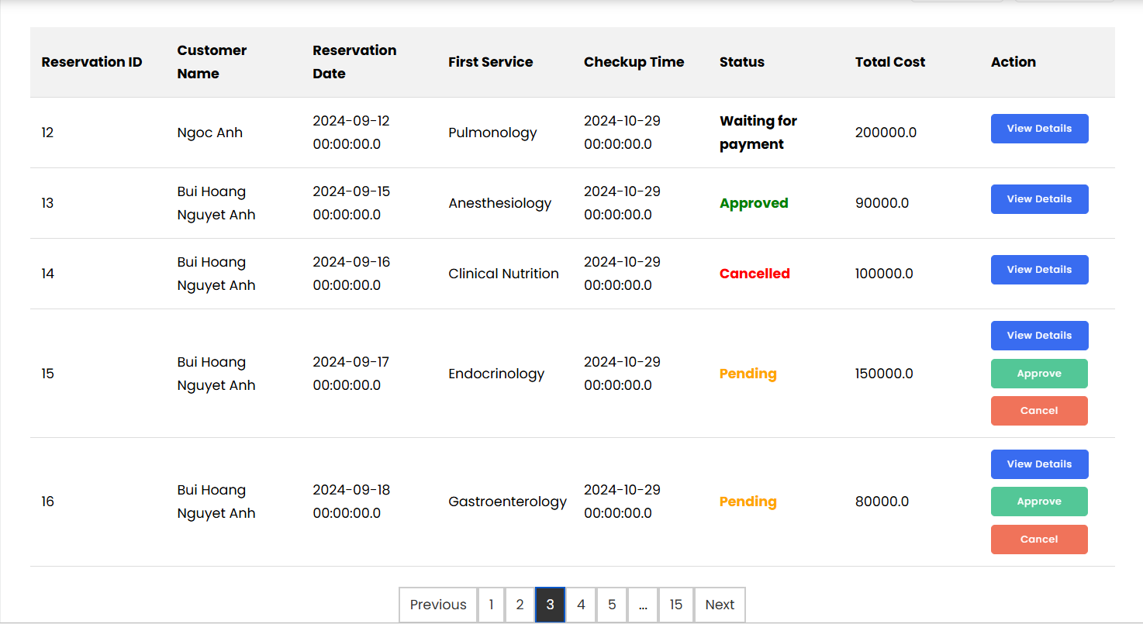
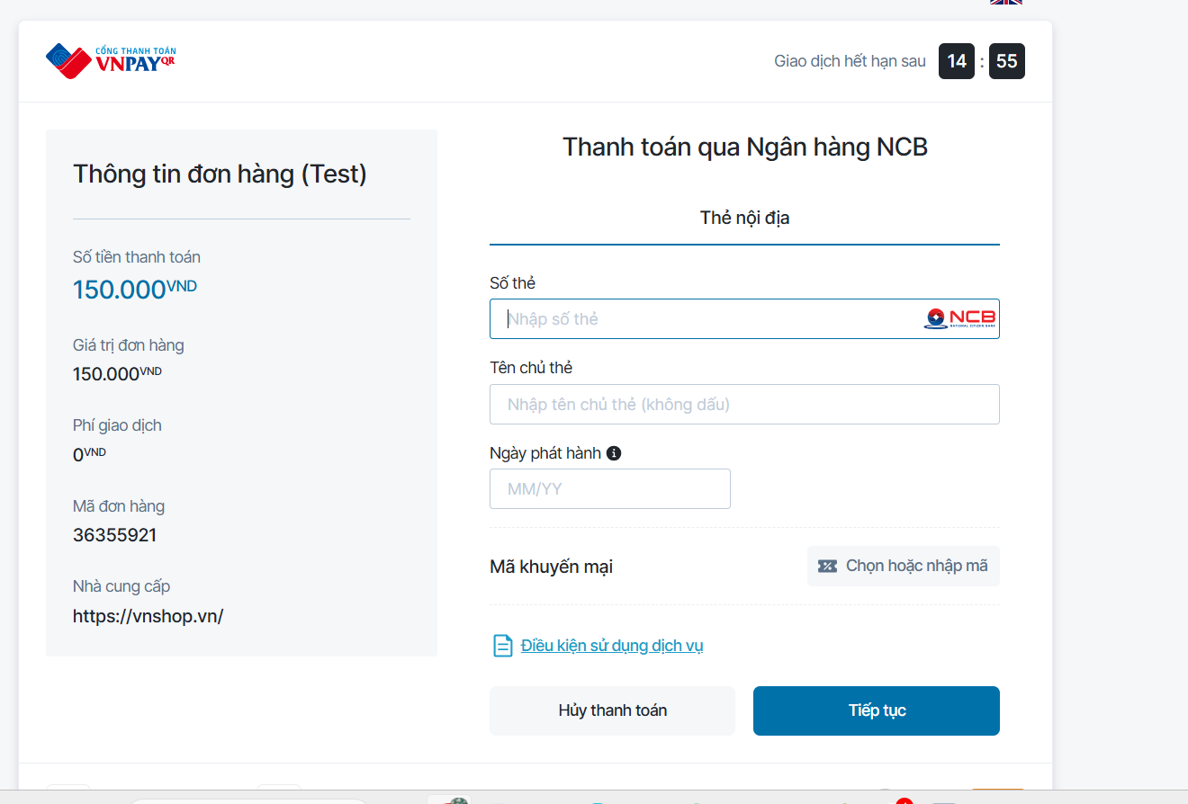
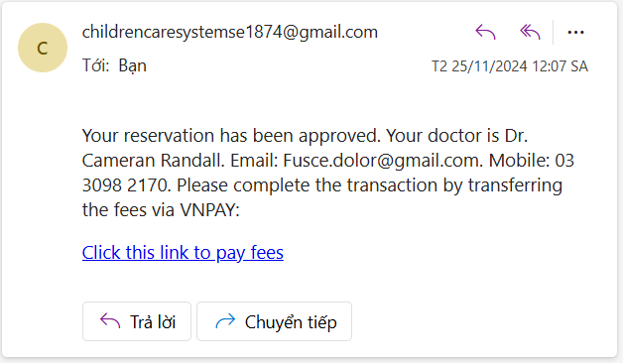
Demonstration| Reservation Management
Add to cart
Booking appointment
Customer

Slide 11
Demonstration| Reservation Management
Add to cart
Booking appointment
Customer

Slide 12





Demonstration| Checkout
Select bill address
Select payment method
Bill address
Customer
Payment method

Slide 13
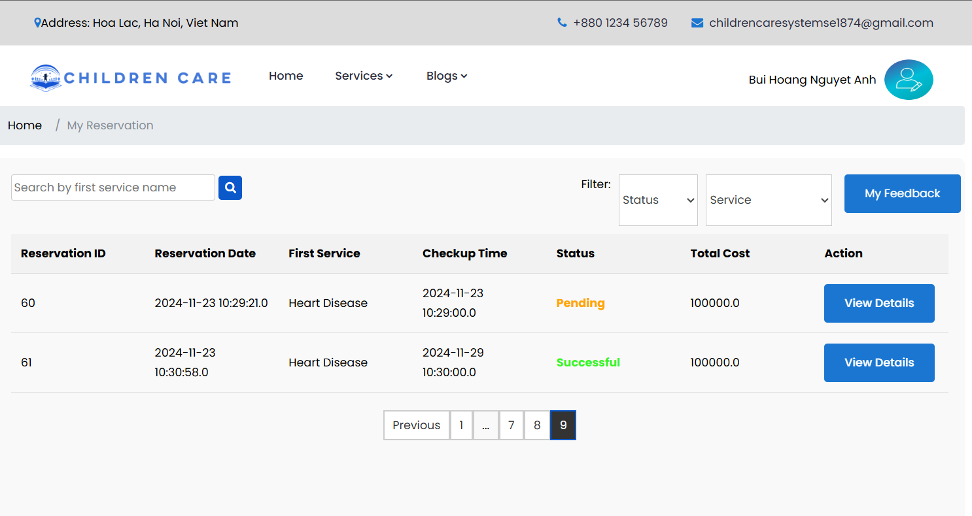

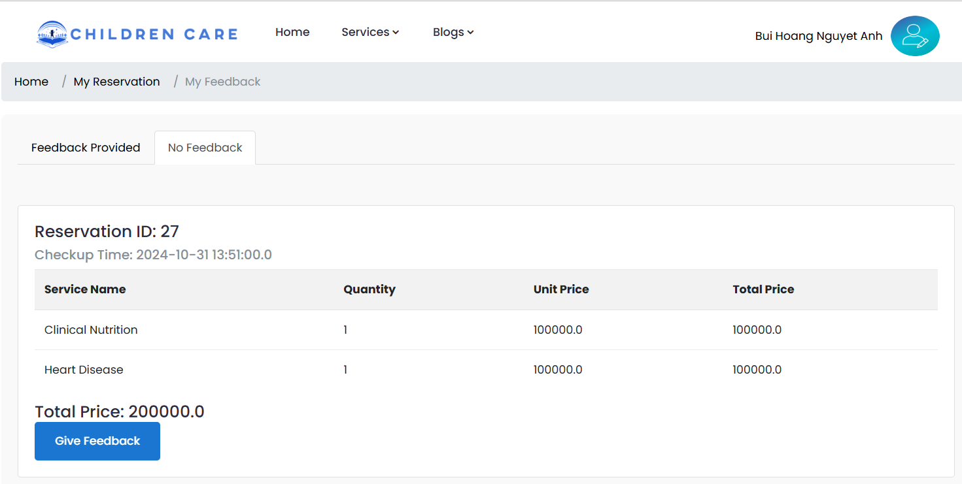
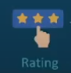
Demonstration| Feedback
Login to system
Go to my reservation
Customer
View reservation has completed
Feedback, Rate

Slide 14
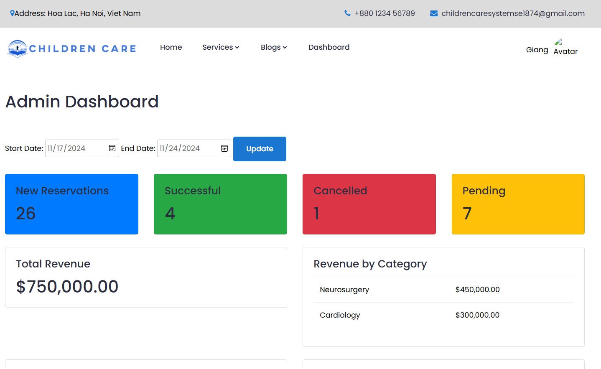

Demonstration| Admin
Login to system
Go to Admin
Dashboard
Admin

Slide 15
5. Outcomes
Lessons learned:
Team work
Time management
SDLC
Project management
Application Achievement:
A trading platform support for providing service
User-Friendly Interface
Limitations:
Lack of Customer Interaction Features
Limited Customer Options
Basic Search Result Sorting Options

Slide 16


